Slide 1

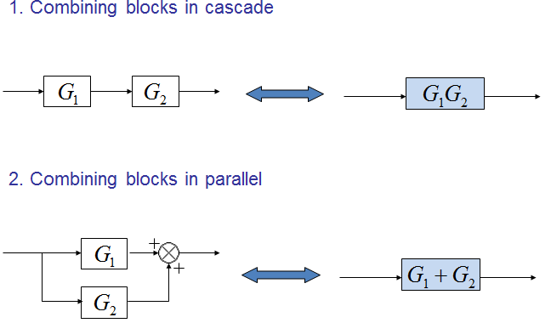
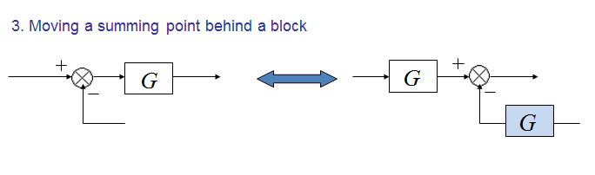
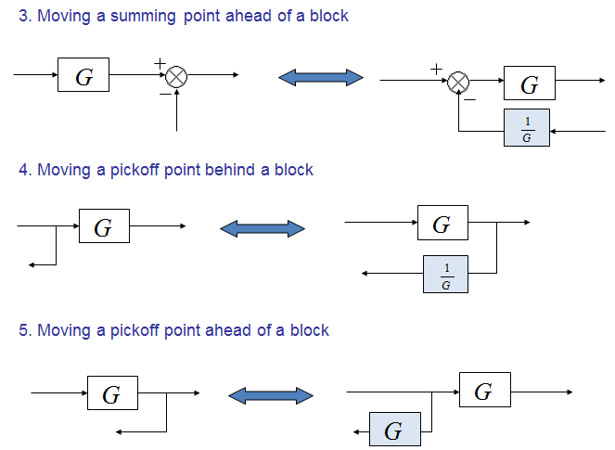
Control Lec. 3
Block Diagram References:
Modern control Engineering by OGATA
Automatic control system by KUO.
Control system Engineering by Norman S. Nise.
http://imtiazhussainkalwar.weebly.com
Block Diagram Transformation Theorems include many rules and these rules are:

Slide 2
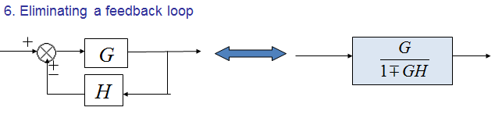
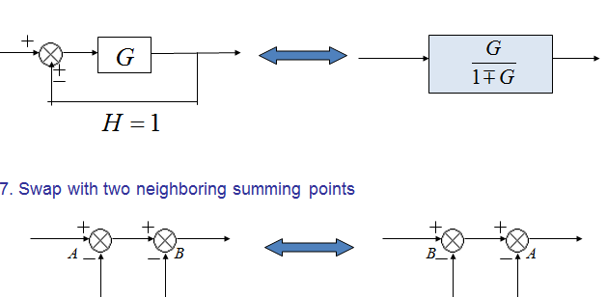
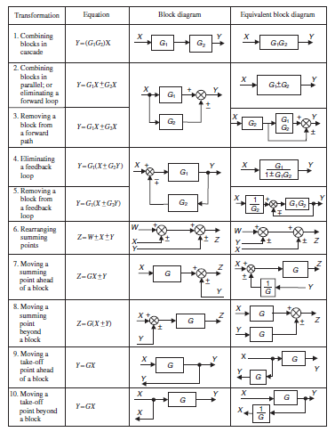
Control Lec. 3
Table (3.1) Block Diagram transformation theorems

Slide 3
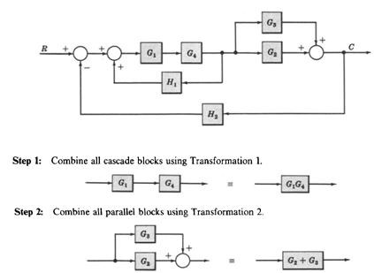

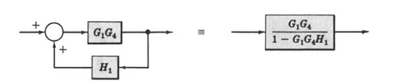
Control Lec. 3
Ex1: Find the transfer function of the following block diagrams
R + G₁ G₂ C R G₁G₂
- + H₁
+ H₂ H₁+H₂
C
R
C
Ex2: Find the transfer function of the following block diagrams

Slide 4
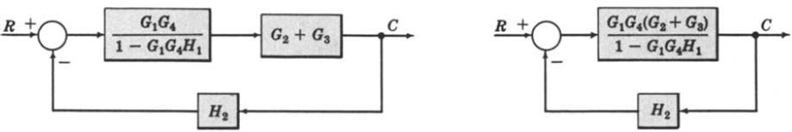
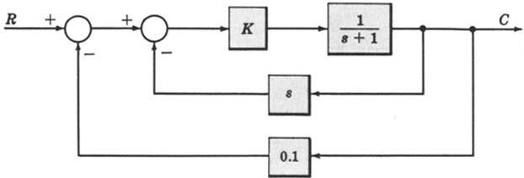
Control Lec. 3
R
C
Ex3: For the system represented by the following block diagram determine:
Open loop transfer function
Feed Forward Transfer function
control ratio
feedback ratio
error ratio
closed loop transfer function
characteristic equation
Sol: First we will reduce the given block diagram

Slide 5

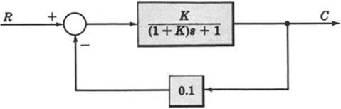
Control Lec. 3
K
s + 1
G
K
₌ s +1
1+ GH
₁₊ K _{s}
s +1
1. Open loop transfer function
B(s) | = G(s)H (s)
E(s)
2. Feed Forward Transfer function
^{C(s)} = G(s)
E(s)
3.control ratio
C(s) | = | G(s)
R(s) |  | 1+ G(s)H (s)
4. feedback ratio
B(s) G(s)H (s)
( )
=
R(s) 1+ G(s)H (s)
( )
5. error ratio
E(s) | = | 1
R(s) |  | 1+ G(s)H (s)

Slide 6
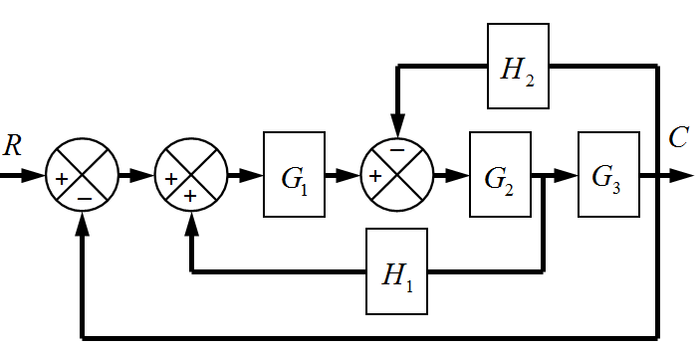
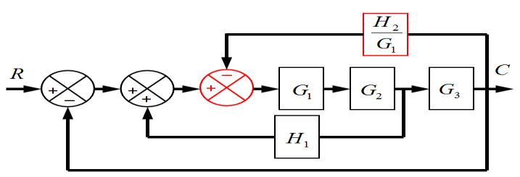
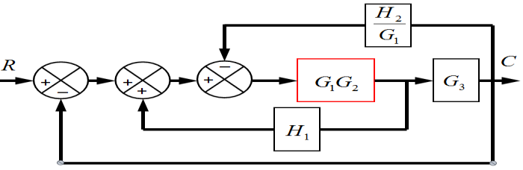
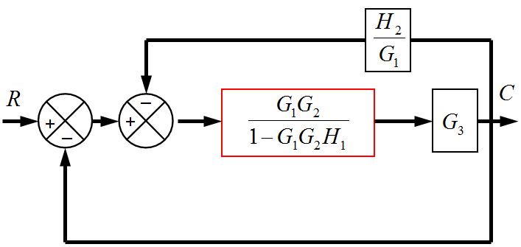
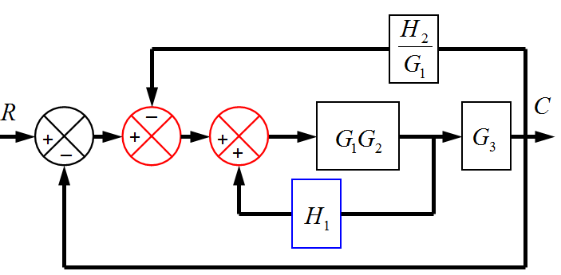
Control Lec. 3
6. closed loop transfer function
C(s) | = | G(s)
R(s) |  | 1+ G(s)H (s)
7. characteristic equation
1+ G(s)H (s) = 0
Ex4: Find the transfer function of the following block diagrams

Slide 7
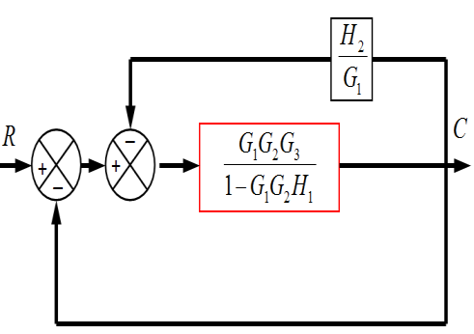
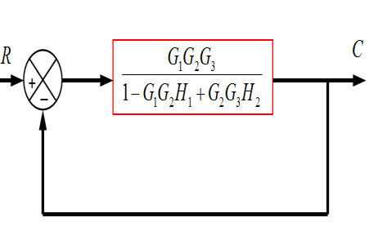
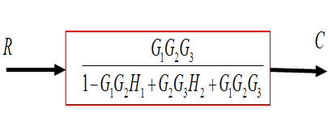
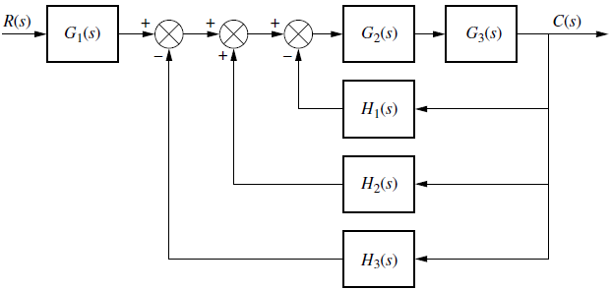
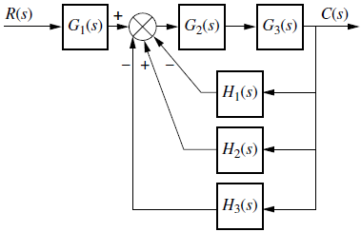
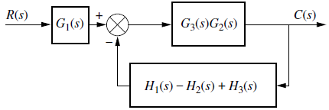
Control Lec. 3
Ex5: Reduce the Block Diagram

Slide 8

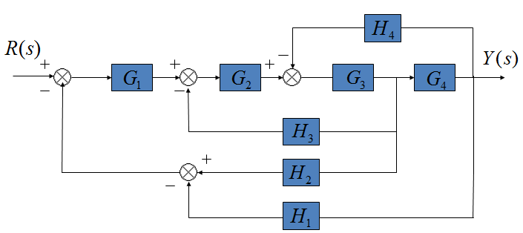
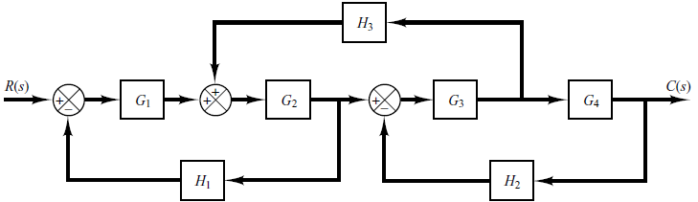
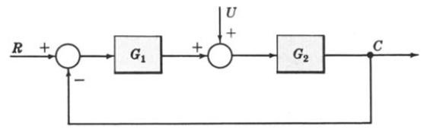
Control Lec. 3
H.W1: Find the transfer function of the following block diagrams
H.W2: Simplify the block diagram then obtain the close-loop transfer function C(S)/R(S).
Multiple Input System
EX1: Determine the output C due to inputs R and U using the Superposition Method
sol: according to the principles of superposition, then, we must try to find the o/p considering one i/p at time

Slide 9

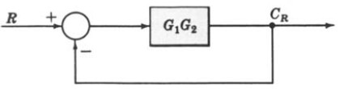
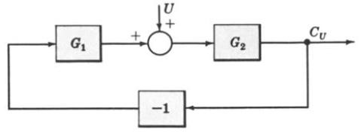
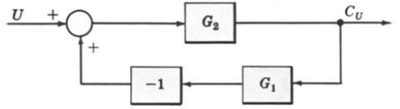
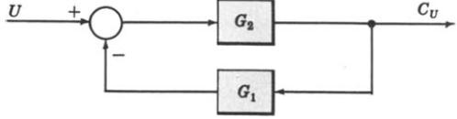


Control Lec. 3

Slide 10
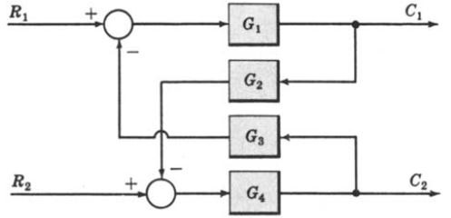
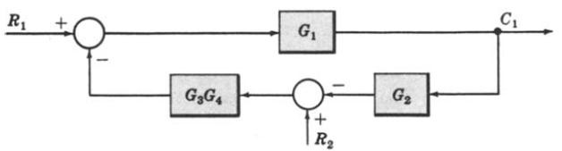
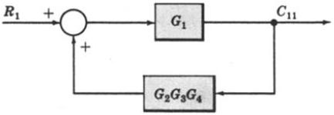
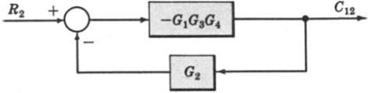
Control Lec. 3
Multi-Input Multi-Output System
Ex1: Determine C1 and C2 due to R1 and R2.
Page 10

Slide 11
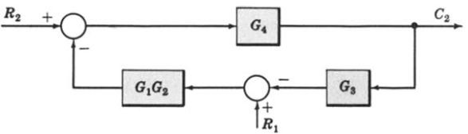
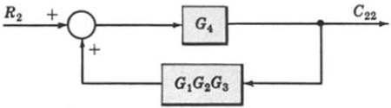
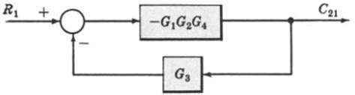
Control Lec. 3
When R1 = 0
When R2 = 0

Slide 12
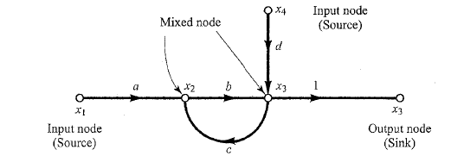
Control Lec. 3
Signal Flow Graphs
The block diagram is useful for graphically representing control system dynamics and is used extensively in the analysis and design of control systems. An alternate approach for graphically representing control system dynamics is the signal flow graph approach, due to S.
Mason. It is noted that the signal flow graph approach and the block diagram approach yield the same information and one is in no sense superior to the other.
Definitions: Before we discuss signal flow graphs, we must define certain terms:
  Node: A node is a point representing a variable or signal.
  Transmittance: The transmittance is a real gain or complex gain between two nodes.
Such gains can be expressed in terms of the transfer function between two nodes.
  Branch: A branch is a directed line segment joining two nodes. The gain of a branch is a transmittance.
  Input node or source: An input node or source is a node that has only outgoing branches.
  Output node or sink: An output node or sink is a node that has only incoming branches.
  Mixed node: A mixed node is a node that has both incoming and outgoing branches.
  Path: A path is a traversal of connected branches in the direction of the branch arrows.
  Loop: A loop is a closed path.
  Loop gain: The loop gain is the product of the branch transmittances of a loop.
  Non touching loops: Loops are nontouching if they do not possess any common nodes.
  Forward path: A forward path is a path from an input node (source) to an output node (sink) that does not cross any nodes more than once.
Forward path gain: A forward path gain is the product of the branch transmittances of
a forward path.
Figure (3.1) Signal flow graph

Slide 13
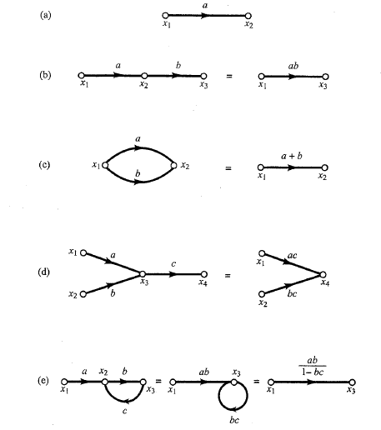
Control Lec. 3
Signal Flow Graph Algebra
A signal flow graph of a linear system can be drawn using the foregoing definitions. In doing so, we usually bring the input nodes (sources) to the left and the output nodes (sinks) to
the right. The independent and dependent variables of the equations become the input nodes (sources) and output nodes (sinks), respectively. The branch transmittances can be obtained from the coefficients of the equations. To determine the input-output relationship, we may use Mason's formula, which will be given later, or we may reduce the signal flow graph to a graph containing only input and output nodes. To accomplish this, we use the following rules:
The value of a node with one incoming branch, as shown in Figure 3-1(a), is x2 =
ax1.
The total transmittance of cascaded branches is equal to the product of all the branch transmittances. Cascaded branches can thus be combined into a single branch by multiplying the transmittances, as shown in Figure 3-1(b).
Parallel branches may be combined by adding the transmittances, as shown in Figure 3-1(c).
A mixed node may be eliminated, as shown in Figure 3-1(d).
A loop may be eliminated, as shown in Figure 3-1(e). Note that x3 = bx2, x2 = ax1 + cx3
Figure 3-2 Signal flow graphs and simplifications

Slide 14
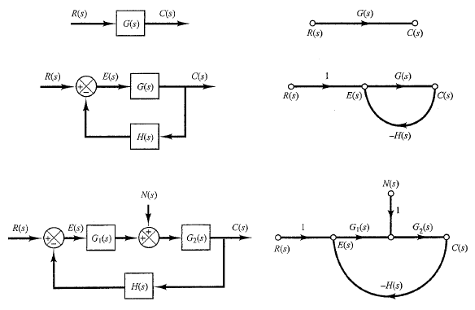
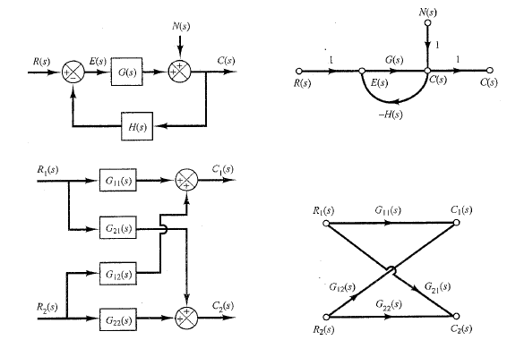
Control Lec. 3
Hence
x3 = abx1+bcx3 (1)
(2)
x3=
Equation (1) corresponds to a diagram having a self-loop of transmittance bc. Elimination of the self-loop yields Equation (2), which clearly shows that the overall transmittance is ab/(l - bc).
Signal Flow Graphs of Control Systems:
Some signal flow graphs of simple control systems are shown in Figure 3-2. For such simple graphs, the closed-loop transfer function C(s)/R(s)[ or c(s)/N(s)]can be obtained easily by
inspection. For more complicated signal flow graphs, Mason's gain formula is quite useful.
Figure 3-3 Block diagrams and corresponding signal flow graphs

Slide 15
Control Lec. 3
Mason's Gain Formula for Signal Flow Graphs
The block diagram reduction technique requires successive application of fundamental relationships in order to arrive at the system transfer function. On the other hand, Mason’s rule for reducing a signal-flow graph to a single transfer function requires the application of one formula. The formula was derived by S. J. Mason when he related the signal-flow graph to the simultaneous equations that can be written from the graph.
The transfer function, C(s)/R(s), of a system represented by a signal-flow graph is:
n
C (s)
R(s)
∑ ^{P}i ^{Δ}i i =1
=
Δ
Where
n = number of forward paths.
P_{i} = the i ^{th} forward-path gain.
∆ = Determinant of the system or is a series of summation of the untouched loops
∆_{i} = Determinant of the i^{th} forward path
∆ is called the signal flow graph determinant or characteristic function
∆ = 1- (sum of all individual loop gains) + (sum of the products of the gains of all possible two loops that do not touch each other) – (sum of the products of the gains of all possible three loops that do not touch each other) + … and so forth with sums of higher number of non-touching loop gains
∆_{i} = value of Δ for the part of the block diagram that does not touch the i-th forward path (Δ_{i}
= 1 if there are no non-touching loops to the i-th path.)
Solution steps by Mason's rule
Calculate forward path gain P_{i} for each forward path i.
Calculate all loop transfer functions
Consider non-touching loops 2 at a time
Consider non-touching loops 3 at a time
Etc

Slide 16
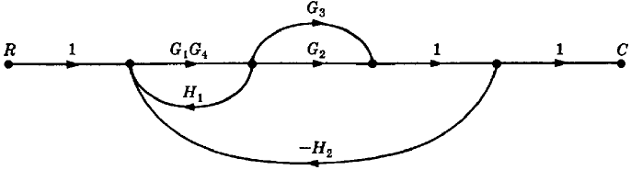



Control Lec. 3
Calculate Δ from steps 2,3,4 and 5
Calculate Δ_{i} as portion of Δ not touching forward path i
Example1: Apply Mason’s Rule to calculate the transfer function of the system represented by following Signal Flow Graph
Therefore
C R
=
P₁Δ₁ + P₂ Δ ₂
Δ
There are three feedback loops
L₁ = G₁G₄ H₁, L₂ = −G₁G₂G₄ H ₂ ,
There are no non-touching loops, therefore
∆ = 1- (sum of all individual loop gains)
Δ = 1 − (L₁ + L₂ + L₃ )
Δ = 1 − (G₁G₄ H₁ − G₁G₂G₄ H₂ − G₁G₃G₄ H₂ )
Eliminate forward path-1
L₃ = −G₁G₃G₄ H ₂
∆₁ = 1- (sum of all individual loop gains)+...
Eliminate forward path-2
∆₁ = 1
∆₂ = 1- (sum of all individual loop gains)+...
∆₂ = 1

Slide 17
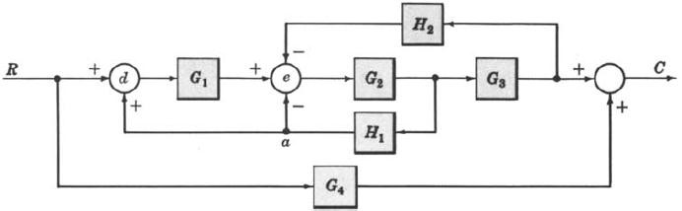
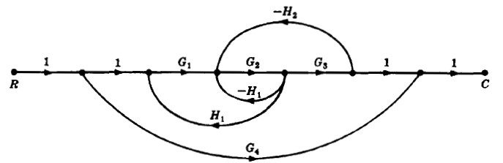

Control Lec. 3
Example-2: Determine the transfer function C/R for the block diagram below by signal flow graph techniques.
Sol:
The signal flow graph of the above block diagram is shown below.
There are two forward paths. The path gains are
The three feedback loop gains are
L₁= -G₂H₁, L₂= G₁G₂H₁, L₃= -G₂G₃H₂
No loops are non-touching, hence
Δ = 1− (L₁ + L₂ + L₃ )
Because the loops touch the nodes of P1, hence
Since no loops touch the nodes of P2, therefore Hence the control ratio T = C/R is:

Slide 18
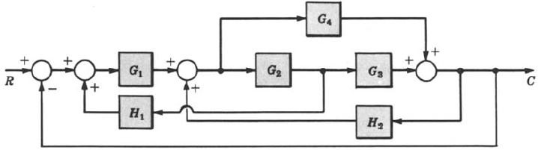
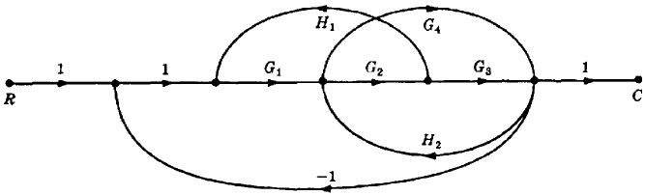

Control Lec. 3
Example-3: Find the control ratio C/R for the system given below.
Sol:
The signal flow graph is shown in the figure.
The two forward path gains are
The five feedback loop gains are
L₁= G₁G₂H₁, L₂= G₂G₃H₂, L₃= -G₁G₂G₃, L₄= G₄H₂, L₅=-G₁G₄
There are no non-touching loops, hence
Δ =1− (L₁ + L₂ + L₃ + L₄ + L₅ )
= 1- G₁G₂H₁- G₂G₃H₂+ G₁G₂G₃- G₄H₂+ G₁G₄
All feedback loops touches the two forward paths, hence Hence the control ratio :

Slide 19
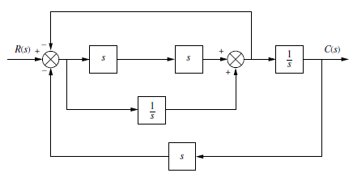
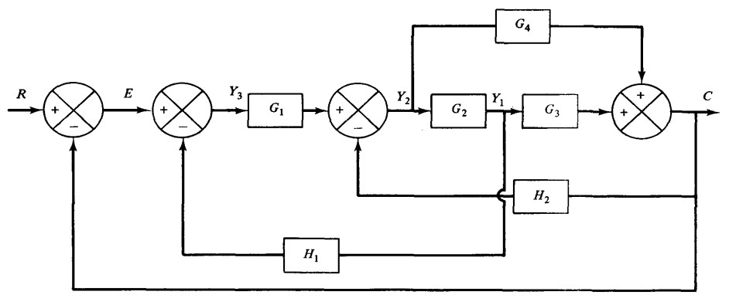
Control Lec. 3
H.W 1: Find the control ratio C/R for the system given below by signal flow graph techniques.
H.W 2: Find the control ratio C/R for the system given below by signal flow graph techniques.

Slide 20
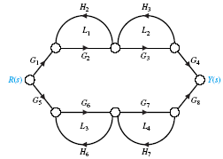
Control Lec. 3
Example 4: Apply Mason’s Rule to calculate the transfer function of the system represented by following Signal Flow Graph
Sol:
Calculate forward path gains for each forward path.
P₁ = G₁G₂G₃G₄ (path 1) and P₂ = G₅G₆G₇G₈ (path 2)
Calculate all loop gains.
L₁ = G₂ H₂ , L₂ = H₃G₃ , L₃ = G₆ H₆ , L₄ = G₇ H₇
Consider two non-touching loops.
L₁L₃ L₂L₄
L₁L₄ L₂L₃
4.
Consider three non-touching loops. None.
5.
Calculate Δ from steps 2,3,4.
Δ = 1 − (L₁ + L₂ + L₃ + L₄ )+ (L₁L₃ + L₁L₄ + L₂ L₃ + L₂ L₄ )
Δ = 1 − (G₂ H ₂ + H ₃G₃ + G₆ H ₆ + G₇ H ₇ ) +
(G₂ H ₂G₆ H ₆ + G₂ H ₂G₇ H ₇ + H ₃G₃G₆ H ₆ + H ₃G₃G₇ H ₇ )
Δ₁ = 1 − (L₃ + L₄ )
Δ₁ = 1− (G₆ H₆ + G₇ H₇ )
Δ₂ = 1 − (L₁ + L₂ )
Δ₂ = 1− (G₂ H₂ + G₃H₃ )
Page 20

Slide 21
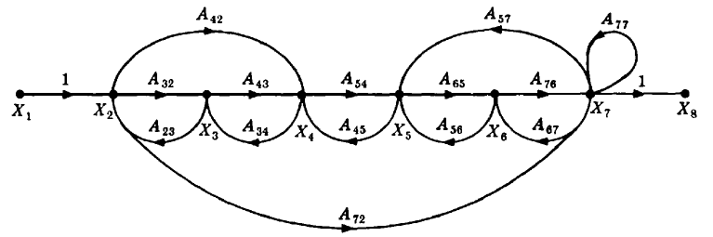
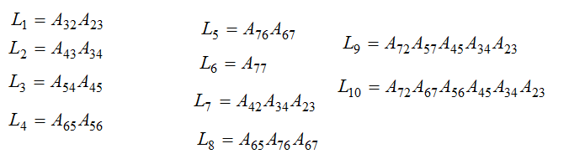

Control Lec. 3
Y (s)
R(s)
=
P₁Δ₁ + P₂ Δ ₂
Δ
Y ( s ) ₌ G₁G₂G₃G₄ [1 − (G₆ H₆ + G₇ H₇ )]+ G₅G₆G₇G₈ [1 − (G₂ H₂ + G₃H₃ )]
R(s) 1 − (G₂ H₂ + H₃G₃ + G₆ H₆ + G₇ H₇ )+ (G₂ H₂G₆ H₆ + G₂ H₂G₇ H₇ + H₃G₃G₆ H₆ + H₃G₃G₇ H₇ )
Example 5: Apply Mason’s Rule to calculate the transfer function of the system represented by following Signal Flow Graph
Sol:
^{P}1 ^{= A}32 ^{A}43^{A}54 ^{A}65 ^{A}76
P₂ = A₇₂
^{P}3 ^{= A}42 ^{A}54 ^{A}65 ^{A}76
two non-touching loops:
Three non-touching loops:
Page 21

